Slide 1
Step 3 Azure Functions

Slide 2
Goal
React when a new message is pushed to an Azure Storage Queue and read the message using Serverless services: Azure Functions.

Slide 3
What is “serverless”
Abstraction of servers
Event-driven scale
Sub-second billing
Notes:
Abstraction of servers, infrastructure and configuration of operating system
Event-driven scale
Sub-second billing
Stateless
Serverless compute is a fully managed service. Some refer to it as Functions as a Service
OS and Framework patching is performed for you
There is zero administrative tasks and no need to manage any infrastructure
You just deploy your code (function) and it runs
Your code runs within seconds and for very short period of time
Serverless compute scales quickly (almost instantly) and vastly
Automatically scales within seconds
No scale configuration is required (there is no way to configure scale or limits)
Scales to match any given workload. Scales from zero to handle tens of thousands concurrent functions invocations within seconds
Pay only for the time your code is running
Serverless compute reacts to events
React, in near real-time, to events and triggers
Triggered by virtually any event from Azure service or 3rd party services

Slide 4
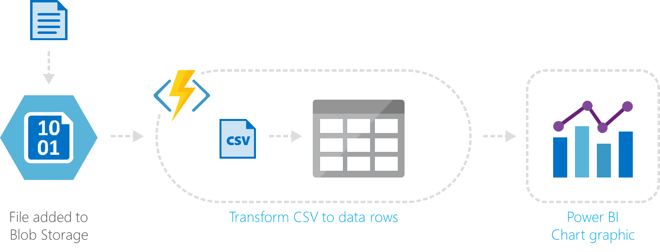
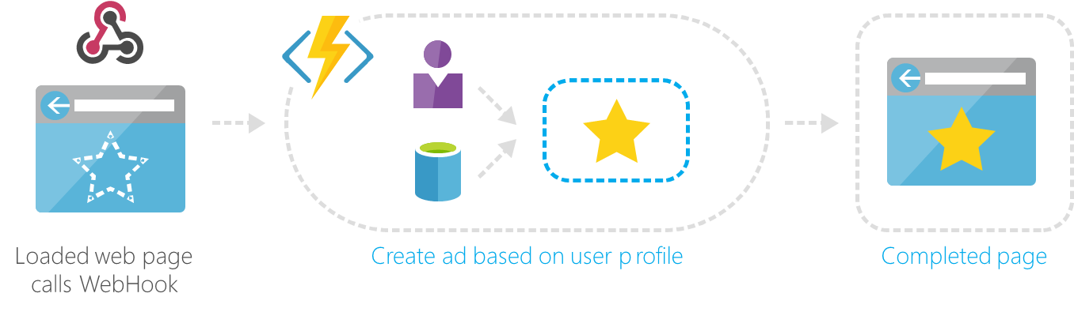
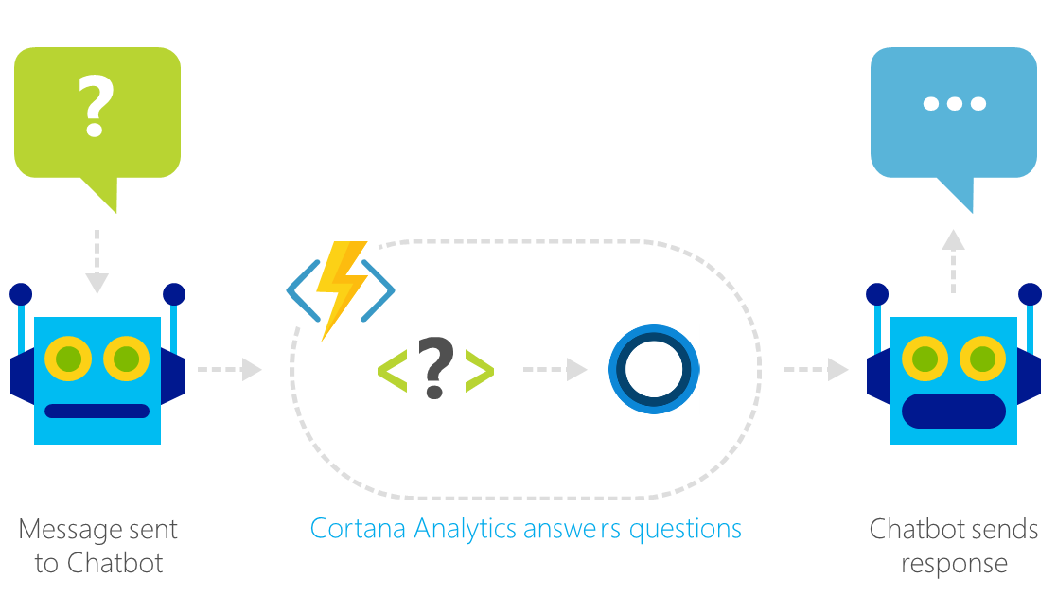
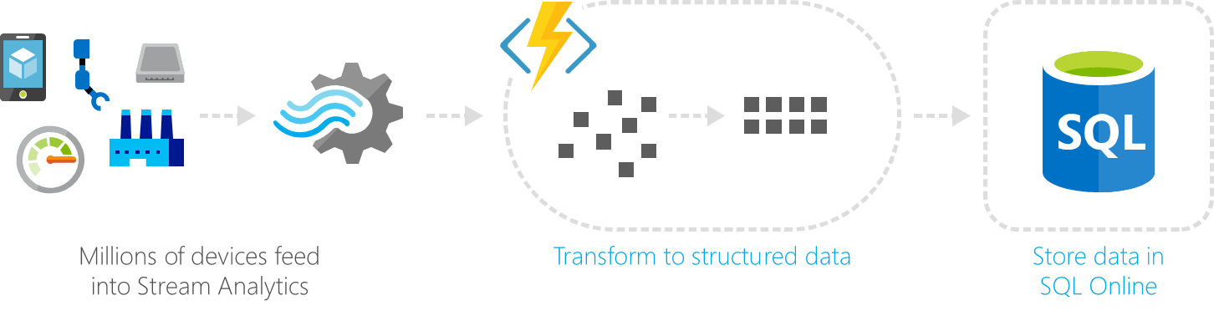
Common Scenarios
Web | Glue
Bots | IoT

Slide 5








Azure Functions
Serverless
Accelerate development
Bind into services
Azure Service Bus
Azure Event Hub
Azure Storage
</>
Dropbox
Sendgrid
AzureDocDb
Event-driven scale
Reduced Dev Ops
Develop your way
Local development
OneDrive
Box
Twilio

Slide 6
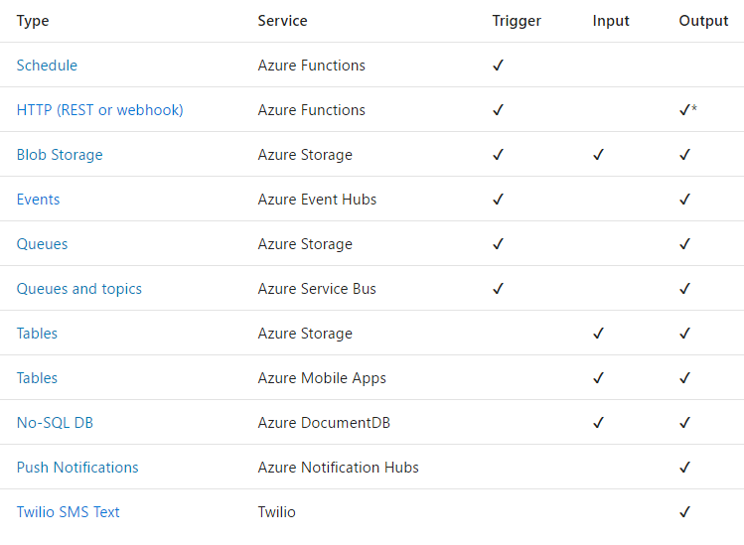
Triggers
and
Bindings

Slide 7
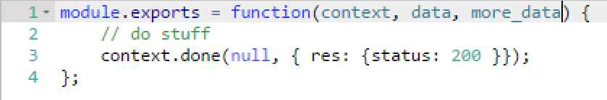
Functions programming concepts
Trigger
Input
Code
Output

Slide 8
Let’s code!

